Slide 1
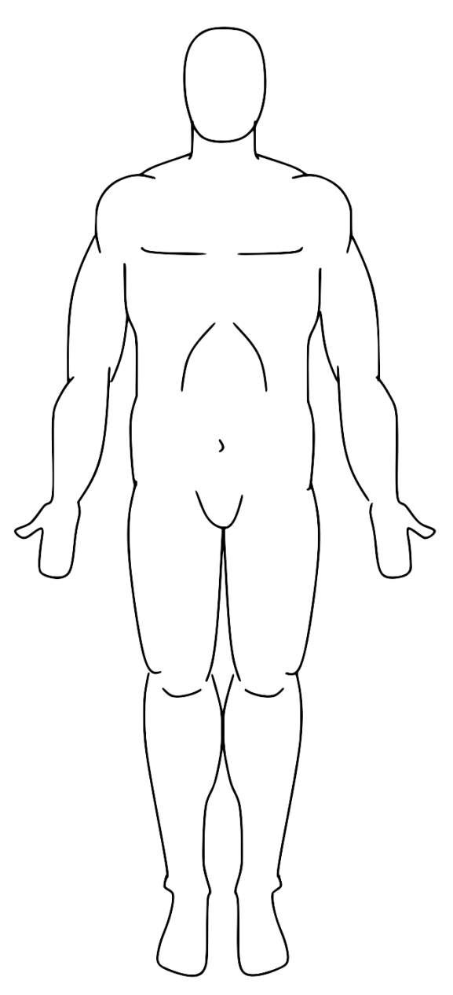
Anatomical position
Notes:
The standard anatomical position for the body is erect, head facing forward, arms by the sides with palms to the front. Left and right are from the subject’s view, not the examiner’s. Anatomical Position represents the basis from which all directions and directional concepts will be developed. Any time we refer to the body, we refer to it as if it was in anatomical position.

Slide 2
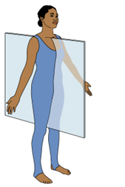
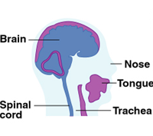
Sagittal plane
Notes:
The sagittal plane vertically divides the body as it passes through the midline to form a right and left half. IF the sagittal plane is along the midline of the body, it is referred to as the mid-sagittal plane. Movement that occurs in this plane goes forward and backward. For example, a person usually walks in the sagittal plane when he walks forward to his destination.

Slide 3
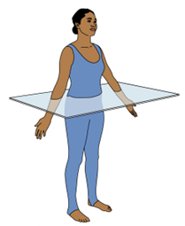
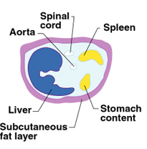
Transverse plane
Notes:
The transverse plane is typically depicted as a horizontal plane bisecting the body at the top of the hips, so that the body is partitioned into superior and inferior, or top and bottom, halves. Movement along this plane occurs on a vertical axis, such as the spine. An example of such a movement is trunk rotation, or twisting of the waist side to side.

Slide 4
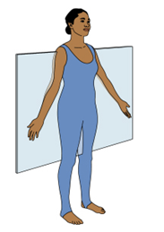
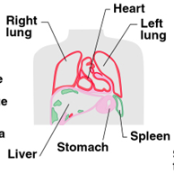
Frontal plane
Notes:
The frontal plane vertically divides the body to form an anterior and posterior, or front and back, side. Movements that occur laterally, or side to side occur in the frontal plane. For example, making snow angels, or doing jumping jacks are movements that would occur in this plane.

Slide 5
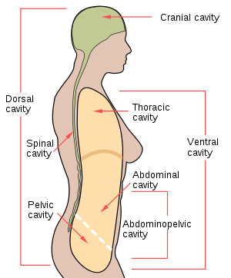
Ventral Cavity
Notes:
The ventral cavity is the hollow portion of the human torso extending from the neck to the pelvis and containing the heart and the organs of respiration, digestions, reproduction, and elimination. The ventral cavity can be subdivided into three distinct areas: thoracic, abdominal, and pelvic. The thoracic contains the heart & lungs. The abdominal cavity contains the kidneys, stomach, intestines, and other organs of digestion. The pelvic cavity contains the organs of reproduction and elimination.

Slide 6
Dorsal cavity
Notes:
The abdominopelvic cavity is the combination of the abdominal and pelvic cavities. The dorsal cavity contains the structures of the nervous system. The dorsal cavity is divided into the cranial cavity and the spinal cavity. The cranial cavity is the space in the skull containing the brain. The spinal cavity is the space within the bony spinal column that contains the spinal cord and spinal fluid.

Slide 7
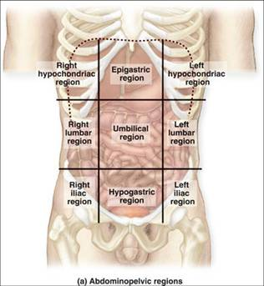
Regions of the abdomen
Notes:
The abdominopelvic cavity is divided into nine regions as a reference for locating visceral organs. A tic-tac-toe pattern drawn across the abdominopelvic cavity delineates the nine regions: The right & left hypochondriac regions, located at the 9th rib; the epigastric over the stomach; the right and left lumbar regions in the middle lateral regions; the umbilical region is in the center, at the navel; the right & left iliac regions are in the lower lateral region; and the hypogastric region is the lower middle region below the navel.

Slide 8
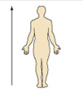
superior
Notes:
Superior refers to above, or in an upward position. It could be toward the head end of the body, or upper part of a body structure. For example, the forehead is superior to the nose. The top of your kneecap would be the superior aspect of the patella.

Slide 9
inferior
Notes:
Inferior means away from the head end or towards the lower part of the body or structure. The navel is inferior to the breastbone. The lower part of the kneecap would be the inferior aspect of the patella.

Slide 10
anterior
Notes:
Anterior means toward or at the front of the body; or in front of. The breast bone is anterior to the spine. You have muscles & ligaments that are on the anterior side of the body and are named accordingly. (i.e., the anteriortalofibular ligament, or ACL).

Slide 11
posterior
Notes:
Posterior means toward or at the backside of the body; or behind. The heart is posterior to the breastbone. It can also be used to identify part of a body. The posterior superior iliac spine is located on the top/back of the hip bone.

Slide 12
medial
Notes:
Medial refers to toward or nearest to the midline. It can also refer to the inner side. The heart is medial to the arm. The insides of your thighs and knees are also on the medial side, so anatomy on that side could be named accordingly: the medial cruciate ligament, the vastus medialis muscle.

Slide 13
lateral
Notes:
Lateral refers to away from the midline or toward the outer side. The arm is lateral to the chest. The outside of the knee is the lateral joint line. Remember though: when talking about the hands & arms—lateral is also based on anatomical position. It doesn’t matter how the arm is held, the pinky side is always medial & the thumb side is always lateral.

Slide 14
intermediate
Notes:
Intermediate is between a more medial and a more lateral structure. The arm pit is intermediate to the breastbone and shoulder. Muscles & other tissues can also be named according to this: the vastus intermedius is between the vastus lateralis and the vastus medialis muscles in the thigh.

Slide 15
proximal
Notes:
Proximal means closest to the origin of the body, or nearest the point of attachment of a limb to the body trunk. The elbow is proximal to the wrist (meaning the elbow is closer to the point of attachment of the arm at the shoulder than the wrist.)

Slide 16
distal
Notes:
Distal means farther from the origin of a body part or the point of attachment of a limb to the point of attachment. The knee is distal to the thigh. The fingers have a proximal, middle and distal phalange.

Slide 17
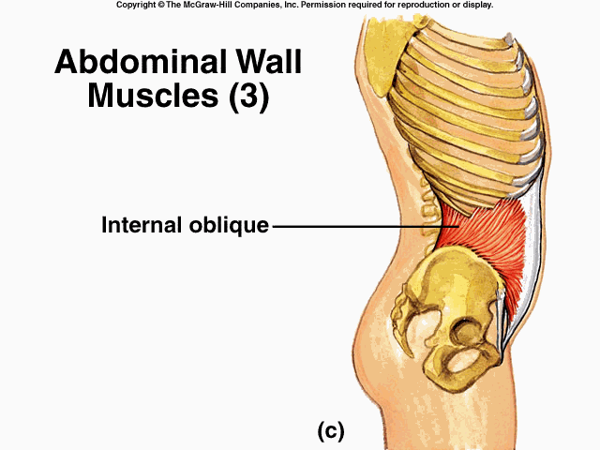
internal
Notes:
inner; not superficial; away from the surface or next to the axis of the body or of a part. The internal obliques are located further in compared to the external obliques. Somebody in an accident may have internal injuries—injuries to their organs.

Slide 18
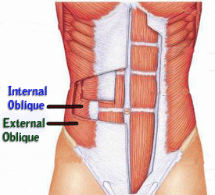
external
Notes:
External means Relating to, existing on, or connected with the outside or an outer part; exterior. External anatomy would be the surface anatomy that you can readily see. The external obliques are located closer to the surface than the internal obliques.

Slide 19
superficial
Notes:
Superficial means toward or at the body surface. Your skin is superficial to the skeleton. A scratch is usually a superficial cut compared to a puncture wound or incision.

Slide 20
deep
Notes:
Deep means away from the body surface or more internal. The lungs are deep to the rib cage. A knife cut would probably be a deep cut.

