Slide 1
Body Movements

Slide 2
Types of Ordinary Body Movements
Flexion
Decreases the angle of the joint
Brings two bones closer together
Typical of hinge joints like knee and elbow
Extension
Opposite of flexion
Increases angle between two bones

Slide 3
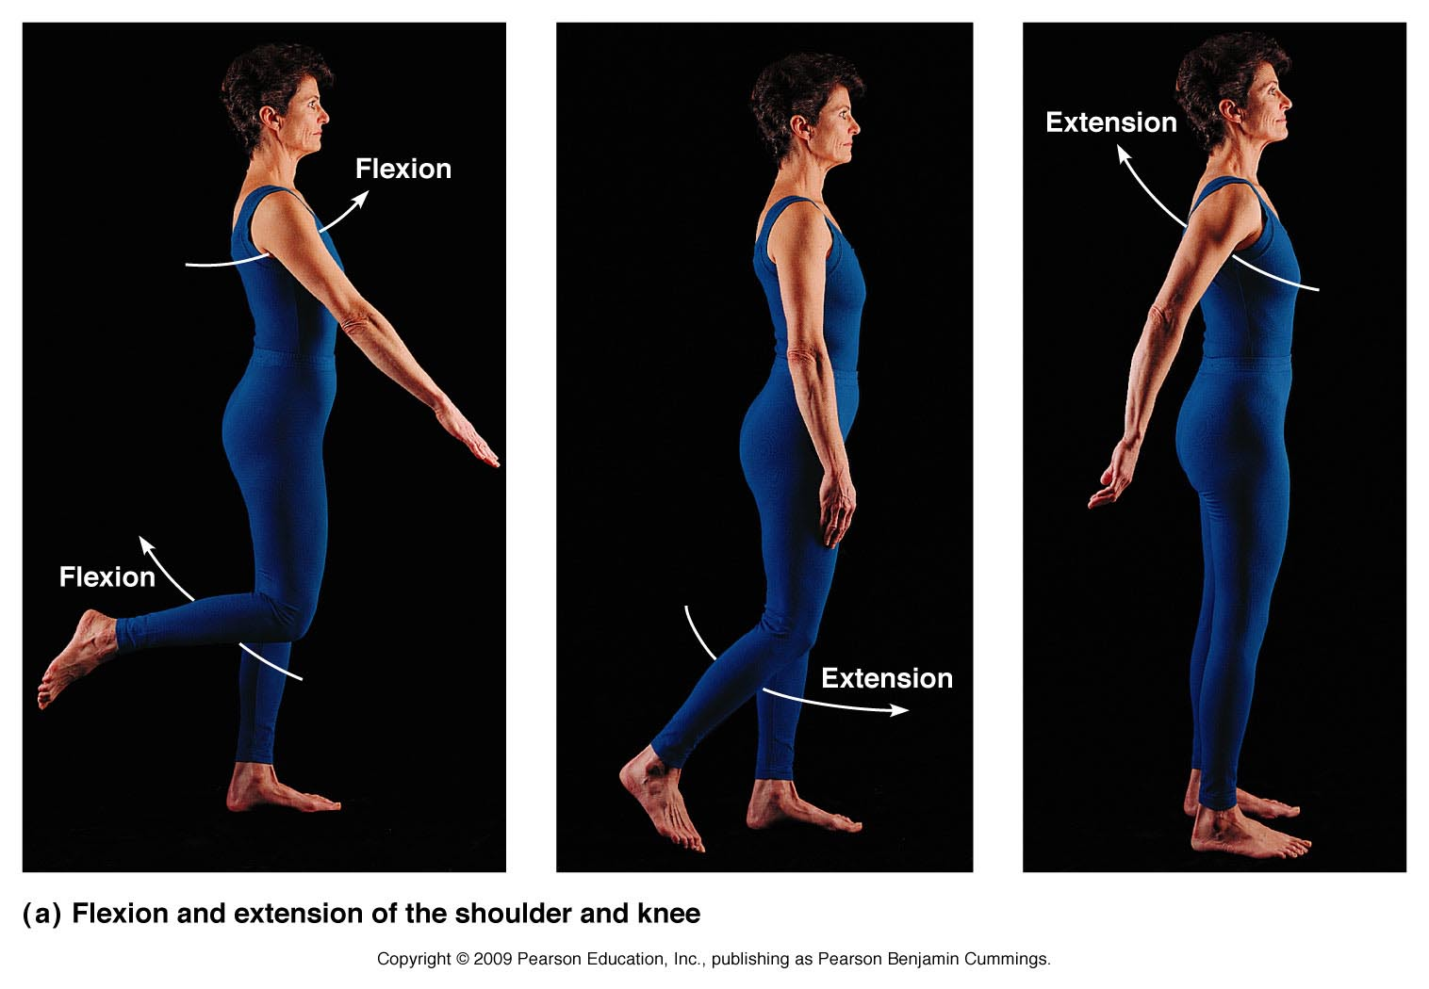
Types of Ordinary Body Movements

Slide 4
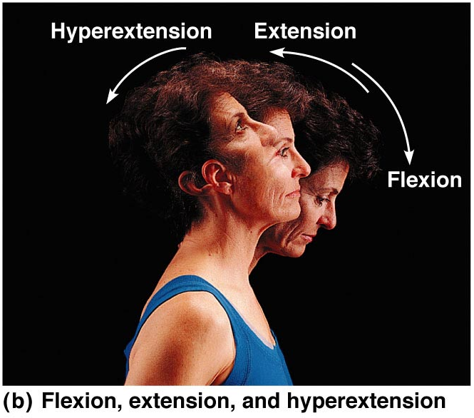
Types of Ordinary Body Movements
Hyperextension: results when angle is > 180 ̊

Slide 5
Types of Ordinary Body Movements
Rotation
Movement of a bone around its longitudinal axis
Common in ball-and-socket joints
Example is when you move atlas around the axis vertebra (shake your head “no”)

Slide 6
Types of Ordinary Body Movements
Abduction
Movement of a limb away from the midline
Adduction
Opposite of abduction
Movement of a limb toward the midline

Slide 7
Types of Ordinary Body Movements
Circumduction
Combination of flexion, extension, abduction, and adduction
Common in ball-and-socket joints

Slide 8
Special Movements
Dorsiflexion
Lifting the foot so that the superior surface approaches the shin
Plantar flexion
Depressing the foot (pointing the toes)

Slide 9
Special Movements
Inversion
Turn sole of foot medially
Eversion
Turn sole of foot laterally

Slide 10
Special Movements
Supination
Forearm rotates laterally so palm faces up (anterior)
Pronation
Forearm rotates medially so palm faces down (posterior)

Slide 11
Special Movements
Opposition
Move thumb to touch the tips of other fingers on the same hand

